Slide 1
Mass Spectrometry

Slide 2
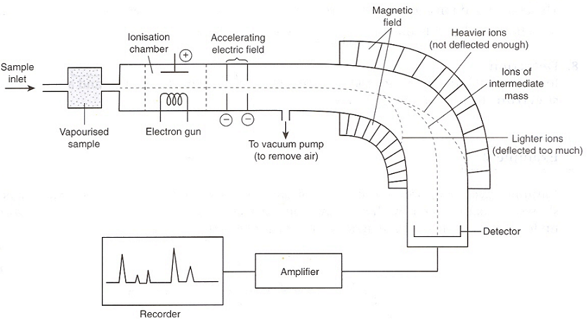

Slide 3
DETERMINATION
USING MASS SPECTROMETRY
is used to identify unknown or new compounds.
When a molecule is ionised, it forms a MOLECULAR ION which can also undergo FRAGMENTATION to produce particles of smaller mass.
Only particles with a positive charge will be deflected and detected.
The resulting spectrum has many peaks.

Slide 4
The final peak (M⁺) shows the molecular ion (highest m/e or m/z value) and indicates the molecular mass.
The rest of the spectrum provides information about the structure.
(fragment ions)

Slide 5
Uses of Mass Spectrometry
Three main ways in which mass spectrometry is applied to the determination of the structures of organic compounds:
1. By measuring the relative heights of the molecular ion (M) peak and the (M+1) peak
→ can determine the number of carbon atoms in a molecule, and by using the (M+2) and (M+4) peaks (if any) we can identify halogen-containing (Cl of Br)compounds.

Slide 6
Uses of Mass Spectrometry
2. By measuring the accurate mass of a molecular ion → can determine its molecular formula.
3. By identifying the fragments produced when an ion breaks up inside a mass spectrometer → can often piece together the structure of the parent molecule.

Slide 7
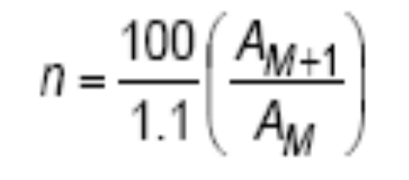
¹²C : ¹³C ratio
Naturally-occurring carbon is composed of 98.9% ¹²C and 1.1% ¹³C (along with extremely small, and variable, amount of ¹⁴C).
The formula relating the (M+1)/(M) ratio the number of carbon atoms is:
where n = number of carbon atoms
A_{M+1} = the abundance of the M+1 peak
A_{M} = the abundance of the molecular ion, M, peak.

Slide 8
Example 1(pg 58)
Compound A has a molecular ion at an m/e value of 120, and relative abundance 23%, and a peak at m/e 121 with a relative abundance of 2%. How many carbon atoms are in a molecule of A?
Answer:

Slide 9
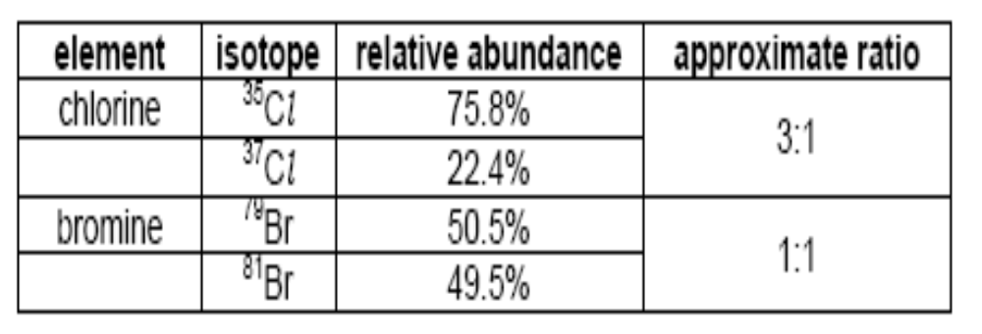
(M), (M+2) and (M+4) peaks
Both Cl & Br naturally occur as mixtures of 2 isotopes, with the relative abundances shown below:

Slide 10
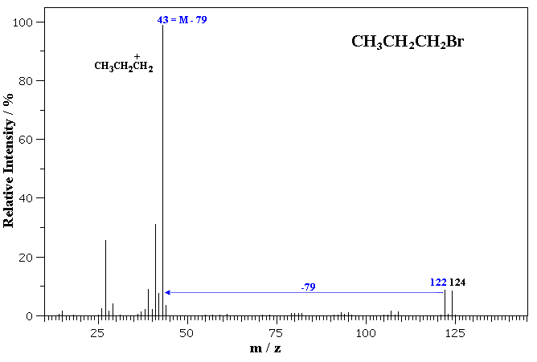
Example: mass spectrum of 1-bromopropane
Note the isotope pattern at 122 and 124 that represent the M amd M+2 in a 1:1 ratio.
Loss of ⁷⁹Br from 122 or ⁸¹Br from 124 gives the base peak a m/z = 43, corresponding to the propyl cation.
Note that other peaks, such as those at m/z = 107 and 109 still contain Br and therefore also show the 1:1 isotope pattern.

Slide 11
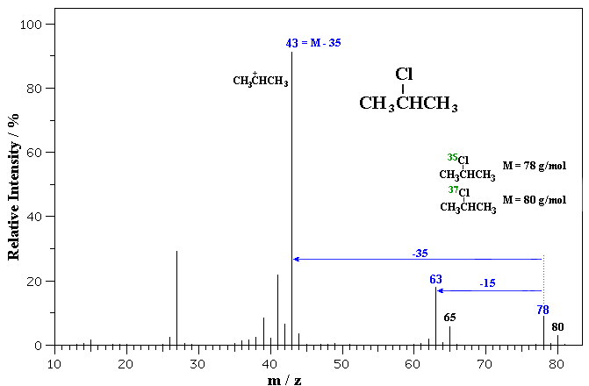
The first MS is of 2-chloropropane.
Note the isotope pattern at 78 and 80 that represent the M amd M+2 in a 3:1 ratio.
Loss of ³⁵Cl from 78 or ³⁷Cl from 80 gives the base peak a m/z = 43, corresponding to the secondary propyl cation.
Note that the peaks at m/z = 63 and 65 still contain Cl and therefore also show the 3:1 isotope pattern.

Slide 12
Molecular formulae from accurate masses
The following three compounds all have an approximate Mr of 70:
name structure molecular
formula
pentene CH₃CH₂CH₂CH=CH₂ C₅H₁₀
aminopropanonitrile CH₃CH(NH₂)CN C₃H₆N₂
but-1-ene-3-one CH₂-CHCOCH₃ C₄H₆O

Slide 13
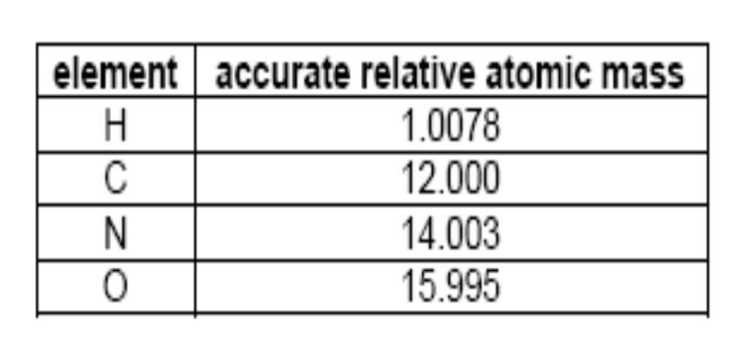

Slide 14
SAQ3 (pg 59)
Explain whether a molecule having an accurate mass of 60.0574 is 1,2-diaminoethane, C₂H₈N₂, or
propan-1-ol, C₃H₈O.
Ans: propan-1-ol, C₃H₈O.

Slide 15
The use of fragmentation patterns
Can be used to identify the structural formulae of compounds.
E.g. Propanone CH₃COCH₃ and
Propanal CH₃CH₂CHO
Both of them have the same
molecular of C₃H₆O with m/e = 58

Slide 16
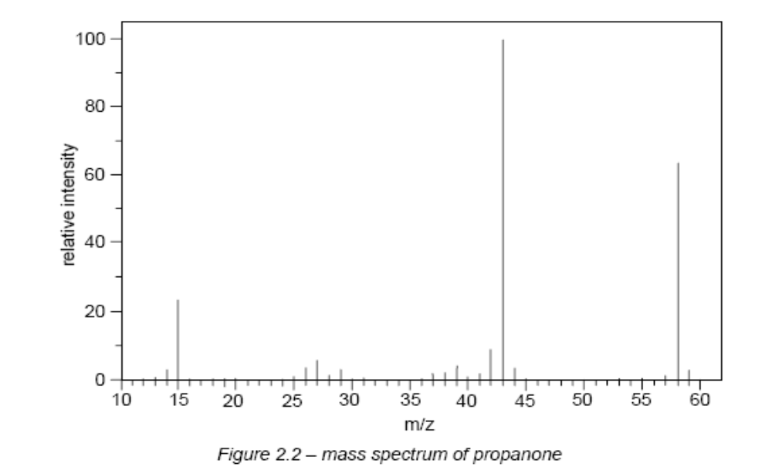
Mass Spectrum of propanone (pg 60)

Slide 17
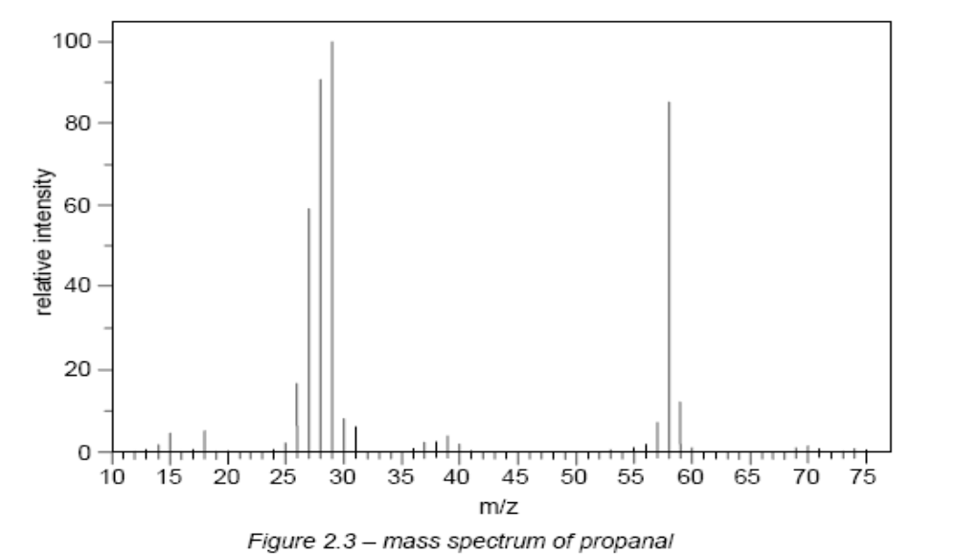
Mass Spectrum of propanal (pg 60)

Slide 18
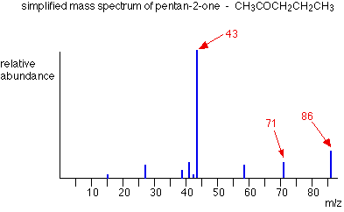

Slide 19
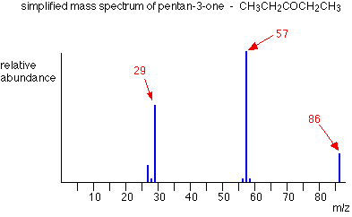

Slide 20
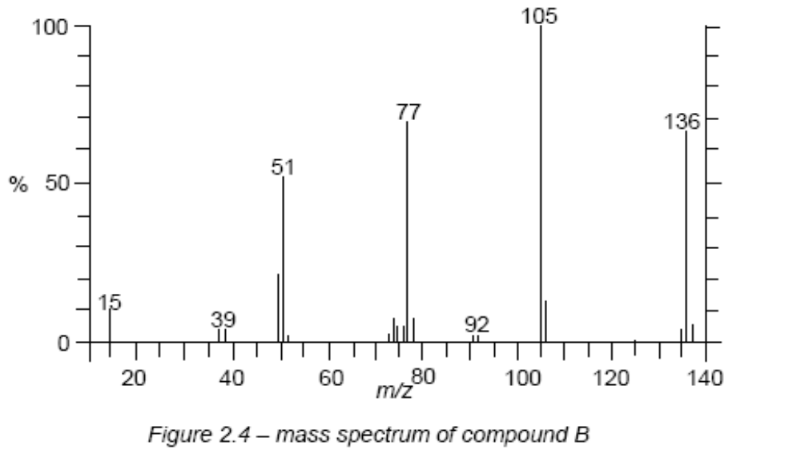
The molecular formula of B is C₈H₈O₂

Slide 21
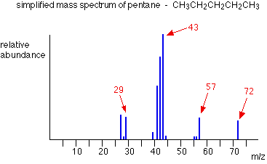

Slide 22
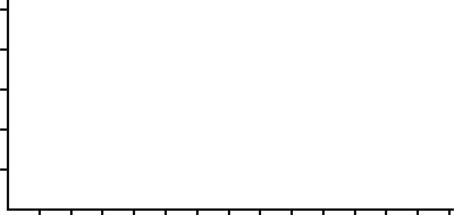
IDENTIFY THE COMPOUND
43
29
Abundance %
20 40 60 80 100
122 124
79 81
0
m/z
10 20 30 40 50 60 70 80 90 100 110 120 130 140
C₃H₇Br

Slide 23
IDENTIFY THE COMPOUND
105
77
51
Abundance %
20 40 60 80 100
120
43
28
0
m/z
10 20 30 40 50 60 70 80 90 100 110 120 130 140
C₆H₅COCH₃

